Slide 1


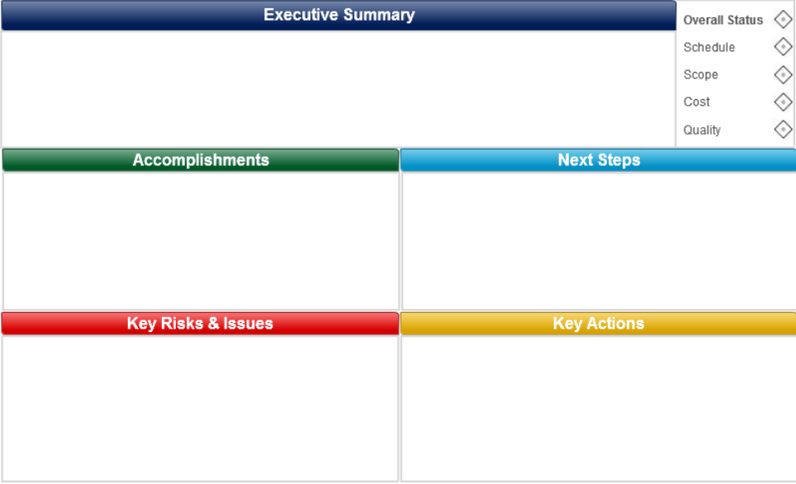
PROJECT: IPCT FE Developer: Martín Rodríguez REPORT DATE: 13/04/2018 – W15
Progress: 70%
FINANCIALS (KUSD)
Now is possible to see reports (tables and charts) by user and date on report section
User management module with option to see the registered users and to change roles
Different limits were added to the add hours and expenses modules on the activities section
Some changes were made to align with the last meeting notes
N/A at this momment
Report section connected to firebase db
Added: chart and table modules for report section
Users section created with list of registered users and method to change the role of the users
Added: 8hrs limit/day, after that, extra hrs is active
Added: selected day on modal to add hours & expenses
Added: client, pcode, description on project overview
Change: user only see his activities and expenses
Added: don’t allow to register hours & expenses after limit
Pending Tasks:
Show worked and total hours on activities project overview
Show expended and total budget on activities project overview
On login, if user already exist, don’t overwrite role on db
Expenses module creation (to accept or decline expenses)
Client and task creation module creation
Support Needed
N/A at this momment

